Slide 1
Capstone Project – The Battle of Neighbourhood’s | Finding a Better Place in Scarborough, Toronto

Slide 2
Introduction
The purpose of this Capstone Project is to help people in exploring better facilities around their neighbourhood.
It will help people making smart and efficient decision on selecting great neighbourhood out of numbers of other neighbourhoods in Scarborough, Toronto.
This Capstone Project aim to create an analysis of features for a people migrating to Scarborough to search a best neighbourhood as a comparative analysis between neighbourhoods.
The features include median housing price and better school according to ratings, crime rates of that particular area, road connectivity, weather conditions, good management for emergency, water resources both fresh and waste water and excrement conveyed in sewers and recreational facilities.

Slide 3
Data
Data Link: https://en.wikipedia.org/wiki/List_of_postal_codes_of_Canada:_M
Will use Scarborough dataset which we scrapped from Wikipedia on Week 3. Dataset consisting of latitude and longitude, zip codes.
Foursquare API Data:
We will need data about different venues in different neighbourhoods of that specific borough.
After finding the list of neighbourhood’s, we then connect to the Foursquare API to gather information about venues inside each and every neighbourhood.
For each neighbourhood, we have chosen the radius to be 100 meter.

Slide 4
Data
The data retrieved from Foursquare contained information of venues within a specified distance of the longitude and latitude of the postcodes. The information obtained per venue as follows:
1. Neighbourhood
2. Neighbourhood Latitude
3. Neighbourhood Longitude
4. Venue
5. Name of the venue e.g. the name of a store or restaurant
6. Venue Latitude
7. Venue Longitude
8. Venue Category
.

Slide 5

Data
Map of Scarborough

Slide 6
Methodology
Clustering Approach:
To compare the similarities of two cities, we decided to explore neighbourhoods, segment them, and group them into clusters to find similar neighbourhood’s in a big city like New York and Toronto.
To be able to do that, we need to cluster data this is a form of unsupervised machine learning: k-means clustering algorithm

Slide 7
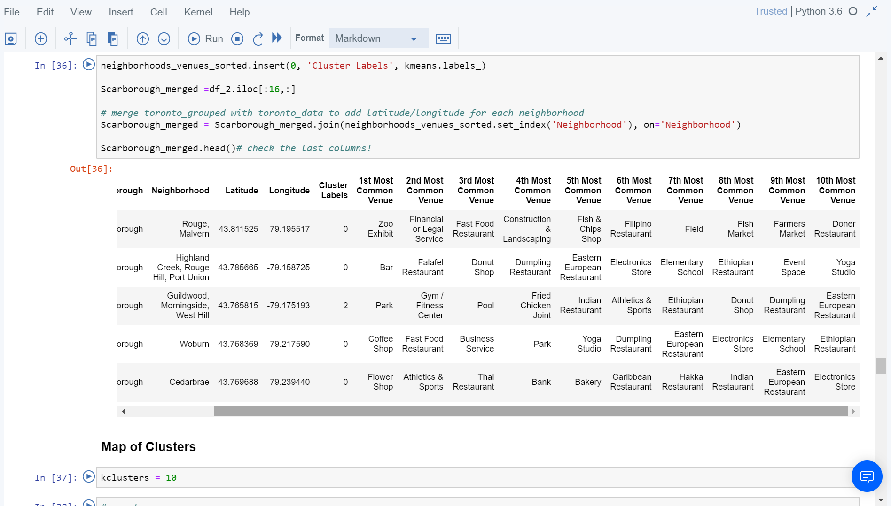
Methodology
Using K-Means Clustering Approach | Most Common Venue

Slide 8
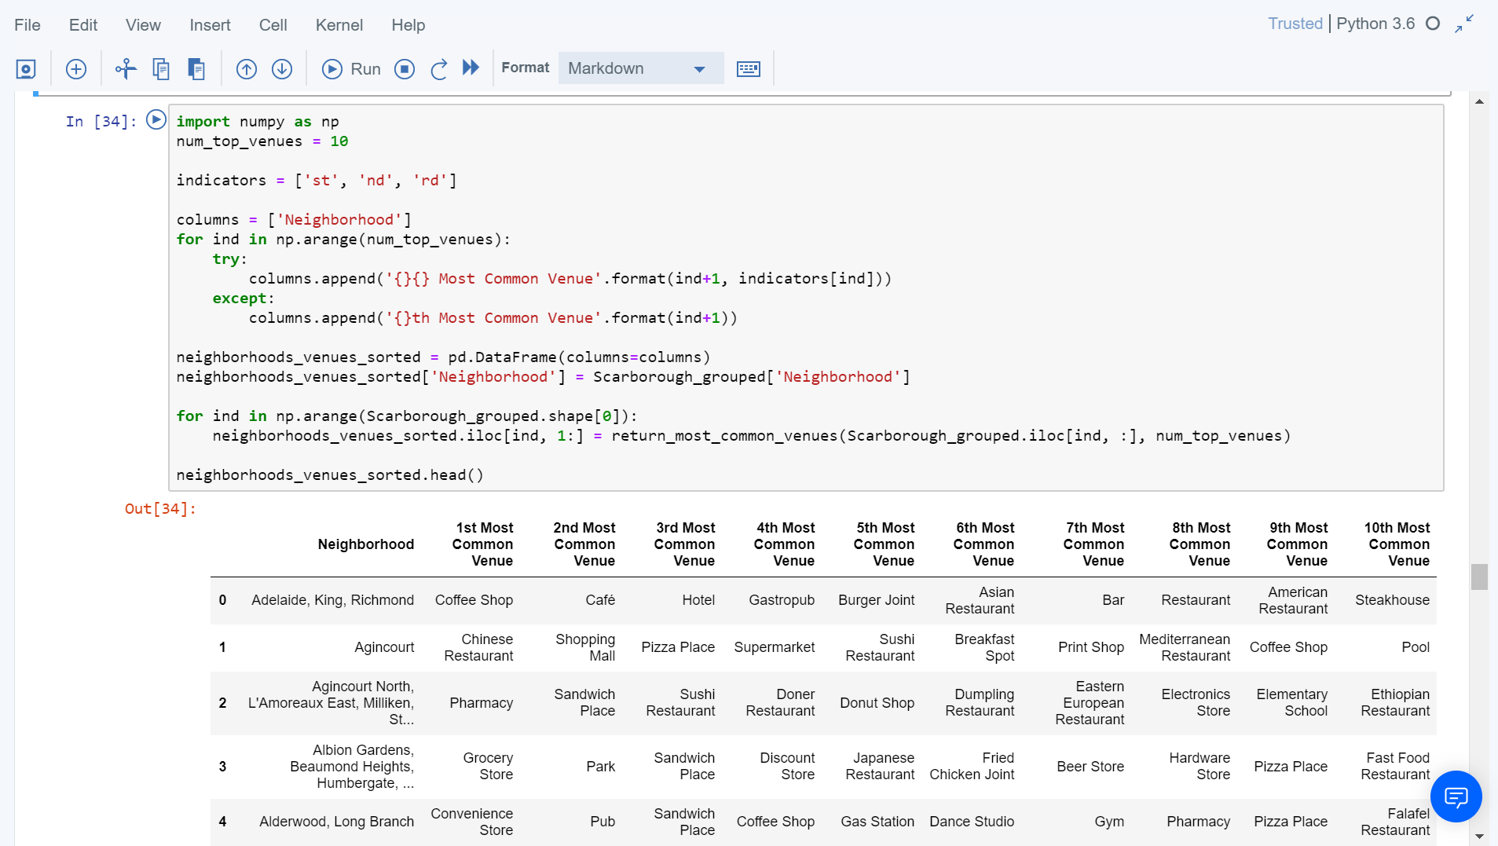
Methodology
Most Common Venues near Neighbourhood | Using Clustering

Slide 9

Results
Map of Clusters in Scarborough

Slide 10
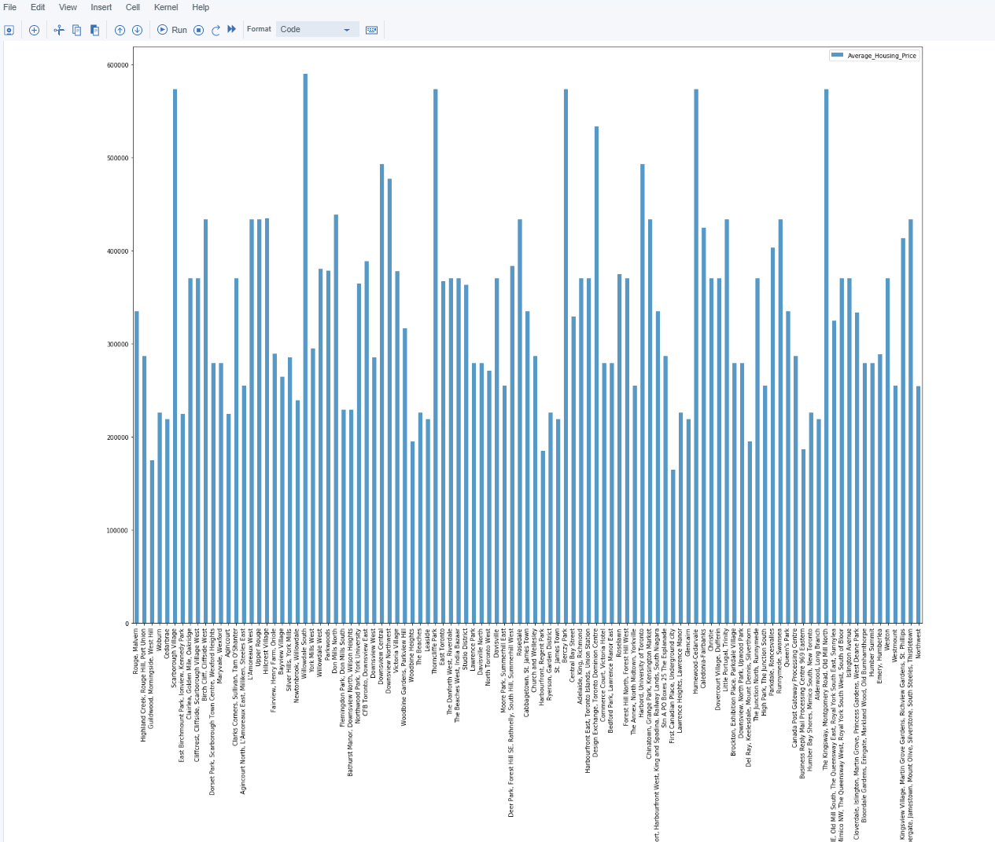
Results
Average Housing Price by Clusters in Scarborough

Slide 11
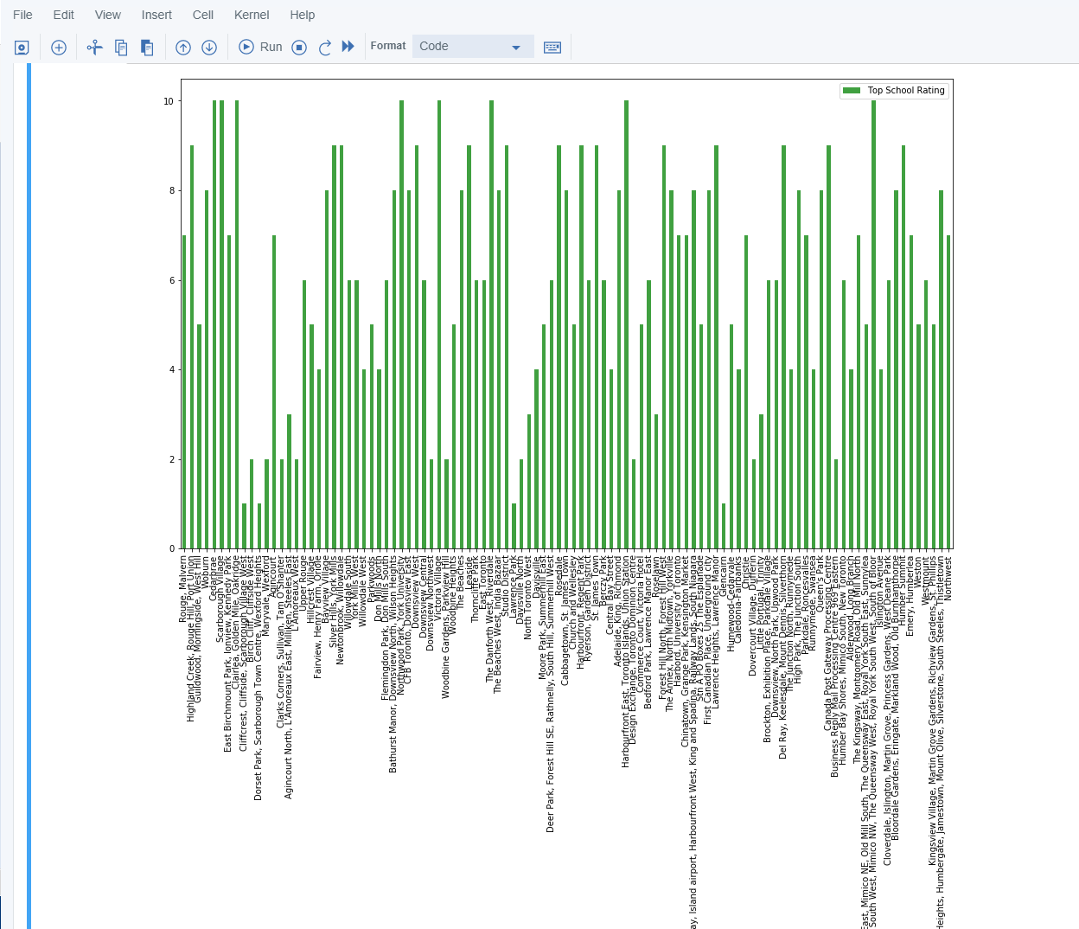
Results
School Ratings by Clusters in Scarborough

Slide 12
Results
The Location:
Scarborough is a popular destination for new immigrants in Canada to reside. As a result, it is one of the most diverse and multicultural areas in the Greater Toronto Area, being home to various religious groups and places of worship.
Foursquare API:
This Capstone project have used Four-square API as its prime data gathering source as it has a database of millions of places, especially their places API which provides the ability to perform location search, location sharing and details about a business.

Slide 13
Discussion
The major purpose of this project, is to suggest a better neighbourhood in a new city for the person who are shifting there.
Social presence in society in terms of likeminded people.
Connectivity to the airport, bus stand, city centre, markets and other daily needs things nearby.
Sorted list of house in terms of housing prices in a ascending or descending order
Sorted list of schools in terms of location, fees, rating and reviews

Slide 14
Conclusion
In this Capstone project, using k-means cluster algorithm I separated the neighbourhood into 10(Ten) different clusters and for 103 different latitude and longitude from dataset, which have very-similar neighbourhood’s around them.
This project has shown me a practical application to resolve a real situation that has impacting personal and financial impact using Data Science tools.
The mapping with Folium is a very powerful technique to consolidate information and make the analysis and decision better with confidence.

Slide 15
Future Works
This Capstone project can be continued for making it more precise in terms to find best house in Scarborough.
Best means on the basis of all required things(daily needs or things we need to live a better life) around and also in terms of cost effective.

Slide 16
THANK YOU

